Slide 1
Project Quality Management
PMI Knowledge Areas

Slide 2
The Importance of Project Quality Management
Scope
Time
Cost

Slide 3
Six Sigma
Six Sigma is “a comprehensive and flexible system for achieving, sustaining, and maximizing business success. Six Sigma is uniquely driven by close understanding of customer needs, disciplined use of facts, data, and statistical analysis, and diligent attention to managing, improving, and reinventing business processes”*
*Pande, Peter S., Robert P. Neuman, and Roland R. Cavanagh, The
Six Sigma Way, New York: McGraw-Hill, 2000, p. xi.

Slide 4
PM Network: Winning Pair
Are Six Sigma and PMBOK different?
Can these be combined?
How do they mesh?
Example

Slide 5
Basic Information on Six Sigma
The target for perfection is the achievement of no more than 3.4 defects per million opportunities
The principles can apply to a wide variety of processes
Six Sigma projects normally follow a five-phase improvement process called DMAIC

Slide 6
DMAIC
DMAIC is a systematic, closed-loop process for continued improvement that is scientific and fact based
DMAIC stands for:
Define
Measure
Analyze
Improve
Control

Slide 7
Six Sigma Projects Use Project Management
The training for Six Sigma includes many project management concepts, tools, and techniques
Examples

Slide 8
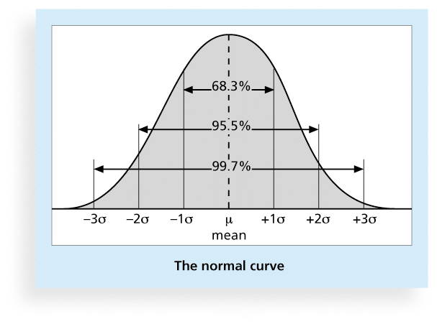
Six Sigma and Statistics
The term sigma means standard deviation
Standard deviation measures how much variation exists in a distribution of data

Slide 9
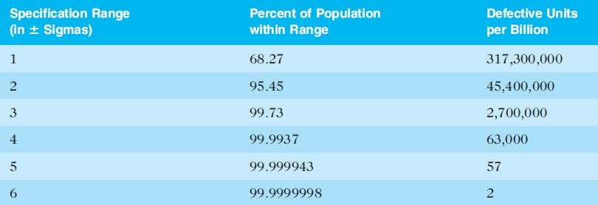
Table 8-2. Sigma and Defective Units

Slide 10
Six 9s of Quality
Six 9s of quality is a measure of quality control equal to 1 fault in 1 million opportunities
In the telecommunications industry, it means 99.9999 percent service availability or 30 seconds of down time a year
This level of quality has also been stated as the target goal for the number of errors in a communications circuit, system failures, or errors in lines of code

Slide 11
Improving Information Technology Project Quality
Several suggestions for improving quality for IT projects include:
Establish leadership that promotes quality
Understand the cost of quality
Focus on organizational influences and workplace factors that affect quality
Follow maturity models

Slide 12
Maturity Models
Maturity models are frameworks for helping organizations improve their processes and systems
Software Quality Function Deployment Model
Capability Maturity Model Integration

Slide 13
CMMI Levels
CMMI levels, from lowest to highest, are:
Incomplete
Performed
Managed
Defined
Quantitatively Managed
Optimizing
Companies may not get to bid on government projects unless they have a CMMI Level 3

Slide 14
PMI’s Maturity Model
PMI released the Organizational Project Management Maturity Model (OPM3) in December 2003
Addresses standards for excellence in project, program, and portfolio management best practices and explains the capabilities necessary to achieve those best practices

Slide 15
Chapter Summary
Project quality management ensures that the project will satisfy the needs for which it was undertaken
Main processes include:
Plan quality
Perform quality assurance
Perform quality control

